Slide 1
GLOBE referatory in Japan
Tsuneo YAMADA
The Open University of Japan

Slide 2
OUJ: Identity
Semi-governmental institution
National center to promote Open Education and Lifelong Learning
“Everyone is welcome”
  No entrance exam (undergraduate courses)
Distance education institution
“Anytime, anywhere”
Liberal Arts institution
  Cope with the growing needs for Practical Abilities

Slide 3
OUJ contributions to
OER community
As a JOCW(OEC) member
  OUJ-OCW site (from October 2010)
    Launched in Video streaming of courseware
  JOCW Search (From October 2006) and GLOBE
    2000+ metadata of JOCW content
As a JMOOC member (From 14th April 2014)
  OUJ MOOC Platform & 2 MOOCs
 | Course (15 lessons) | Lesson (1 lesson) | Special Lecture (1 lesson)
TV(video) | 10 | 31 | 2
Radio (Audio) | 7 | 27 | 5

Slide 4
















GLOBE: An international consortium for reuse and sharing
Cross-Institutional search system of quality learning content and information beyond borders
Exchange and Sharing of METADATA
Federated search and Harvesting
Movement of global coverage, all school level
International level
Nation-wide level
Institution level
University repository level

Slide 5











Global Learning Object Brokered Exchange (GLOBE)
September, 2004
OUJ-CODE
February, 2007
September, 2007
April, 2008
September, 2008
March, 2009
February, 2010
October, 2010
April, 2013

Slide 6
GLOBE Metadata Application Profile (as of January 2014)
GLOBE Mandatory Fields
1.1 General – Identifier 1.2 General – Title 1.3 General – Language 4.3 Technical – Location
GLOBE Recommended Fields
1.4 General – Description 1.5 General – Keywords 2.3.1 Lifecycle – Contribute Role 2.3.2 Lifecycle – Contribute Entity 5.2 Educational – Learning Resource Type 5.6 Educational – Context 6.1 Rights – Cost 6.2 Rights – Copyright and Other Restrictions 6.3 Rights – Description 9.2 Classification – Taxon Path
Optional Fields
All the rest of LOM fields

Slide 7
Japanese collaboration for GLOBE: update
Japanese Team
OUJ-CODE

Slide 8
Metadata elements used in “JOCW Search”
No. | Name | Corresponding element to IEEE 1484.12.1-2002
1. | ID of the metadata | 3.1 Meta-Metadata - Identifier
2. | ID of the LO¹ | 1.1 General - Identifier
3. | Title | 1.2 General - Title
4. | Language(s) used within the LO | 1.3 General - Language
5. | Description | 1.4 General - Description
6. | Keyword(s) | 1.5 General - Keyword
7. | Aggregation level | 1.8 General - Aggregation Level
8. | Contributor to the LO | 2.3 Life Cycle - Contribute
9. | Language of the metadata | 3.4 Meta-Metadata - Language
10. | MIME media types of the LO | 4.1 Technical - Format
11. | URL | 4.3 Technical - Location
12. | Technical requirements to use the LO | 4.4 Technical - Requirement
13. | Educational stages² | 5.6 Educational - Context
14. | Intended learning time | 5.9 Educational - Typical Learning Time
15. | Intended user of the LO | 5.10 Educational - Description
16. | Paid-for or free | 6.1 Rights - Cost
17. | Restriction of usage | 6.3 Rights - Description
18. | Classification³ | 9. Classification
19. | Copyright⁴ | -
20. | Quality⁵ | -
21. | Permission to Harvesting | (for GLOBE Harvesting)
22. | Permission to Federated Search | (for GLOBE Federated search)

Slide 9
New features
The location of New metadata repository
New domestic collaborative frameworks
  NII (National Institute of Informatics) : Sharing metadata with JAIRO (DC-based Harvesting system for HE institutional repositories )
  AXIES (Academic eXchange for Information Environment and Strategies): New policies and test-beds
New OUJ-CODE pilot projects
  “Materials” repository
  Japanese MOOC platform

Slide 10
New metadata repository
(from April 1st, 2014)
OUJ (CODE) Name: Center for Open and Distance Education, the Open University of Japan
Website: http://www.ouj.ac.jp/eng/
SQI Service: [Closed on May 1st, 2013]
OAI Service:
  Service URL: http://globereferatory.ouj.ac.jp/oai
  metadataPrefix: oai_lom

Slide 11
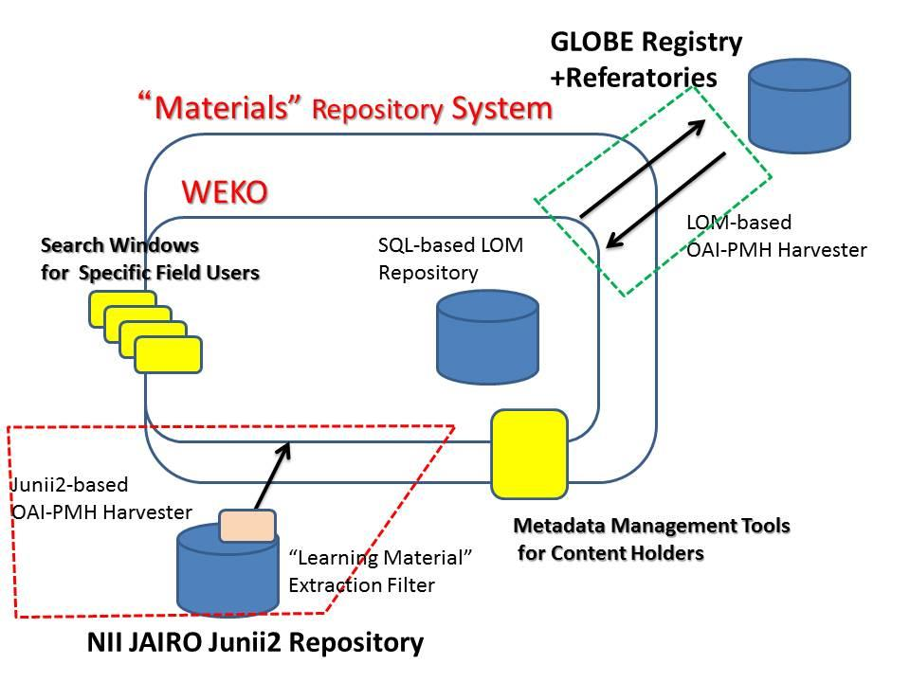
The Metadata Database System

Slide 12
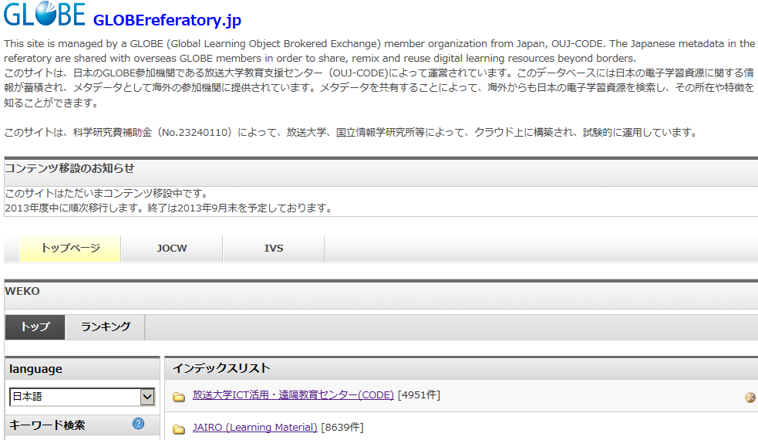
The homepage for Japanese new system

Slide 13


OER Asia Federated Repositories: Concept
AAOU member volunteer
GLOBE Harvesting
OAI-PMH
Target
for GLOBE
Harvester
OAI-PMH
Harvesters
OAI-PMH
Harvesting
Service and
Target
Central
repository
OAI-PMH
Targets
for GLOBE
members
OAI-PMH
Harvester
OER Asia Harvesting
GLOBEreferatory
@Japan (OUJ)
AAOU member universities

